Slide 1
Spotify Dataset Analysis: Trends, Insights, and Recommendations
Exploring Music Trends and Personalization Using Data Science

Slide 2
Why Analyze Spotify Data?
Music streaming platforms have reshaped the music industry.
Spotify provides detailed data for understanding trends and behaviors.
Project goal: Analyze Spotify data to uncover trends, insights, and create personalized song recommendations.

Slide 3
Spotify Dataset
Columns in the dataset:
Track details (name, artist, year, duration).
Musical features (acousticness, danceability, energy, valence, etc.).
Popularity scores and language.
Data Cleaning:
Removed duplicates and missing values.
Standardized numerical features for analysis.

Slide 4
How Did I Analyze the Data?
Preprocessing:
Converted year to integers, calculated song duration in seconds.
Normalized features like acousticness, danceability, etc.
Visualizations:
Used Python and libraries like Pandas, Matplotlib, and Seaborn.
Machine Learning:
Applied K-Means clustering for song recommendations.

Slide 5
Key Analyses and Insights
Popular Songs and Artists:
Top tracks and artists ranked by average popularity scores each year.
Acoustic vs Danceable Songs:
Popular tracks tend to balance danceability and acousticness.
Danceable songs are often more popular.
Yearly Trends in Music:
Danceability has increased over time.
Acousticness shows a gradual decline.
Song Duration Insights:
Song lengths fluctuate, reflecting changing trends in listener preferences.

Slide 6
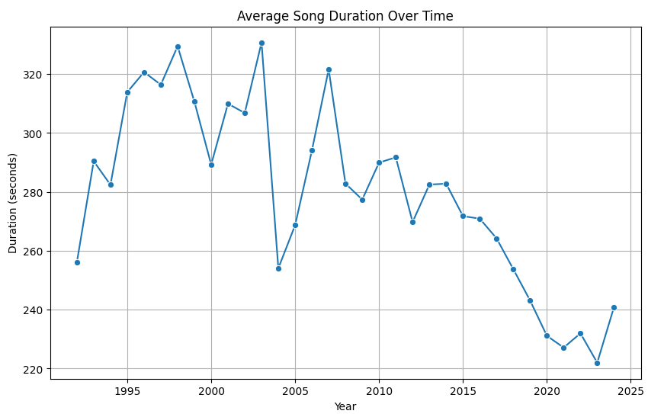

Slide 7
Insights, Challenges, and Conclusion
Key Insights:
Popular songs are typically danceable and upbeat.
Music trends evolve significantly across decades.
Clustering enhances personalized recommendations.
Challenges and Future Scope:
Challenges: Handling missing data and interpreting non-numerical features.
Future Work: Incorporating user listening data for deeper personalization.
Conclusion:
The project highlights Spotify trends and provides groundwork for better recommendations.

